Slide 1

Python | Basic Text Analysis
Presented by Aviv Lo

Slide 2




Table of Contents
Topic 2
Topic 4
AI/ML/NLP Explained
Let’s Code
Topic 1
Topic 3
Python vs. R
Text Analysis

Slide 3
1
Python vs. R

Slide 4

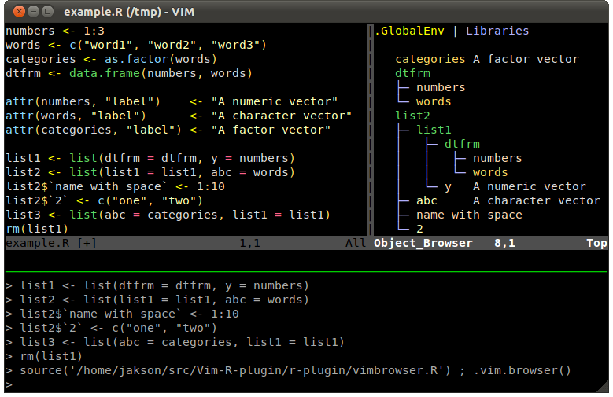
Developed by Ross Ihaka and Robert Gentleman in 1993
Hence the name “R”
Maintained by The R Foundation for Statistical Computing
Difficult for beginners + Steep learning curve
Rich and powerful visualization libraries
Support matrix / vectorized operations
It’s born for stats
Notes:
http://manuals.bioinformatics.ucr.edu/home/programming-in-r

Slide 5

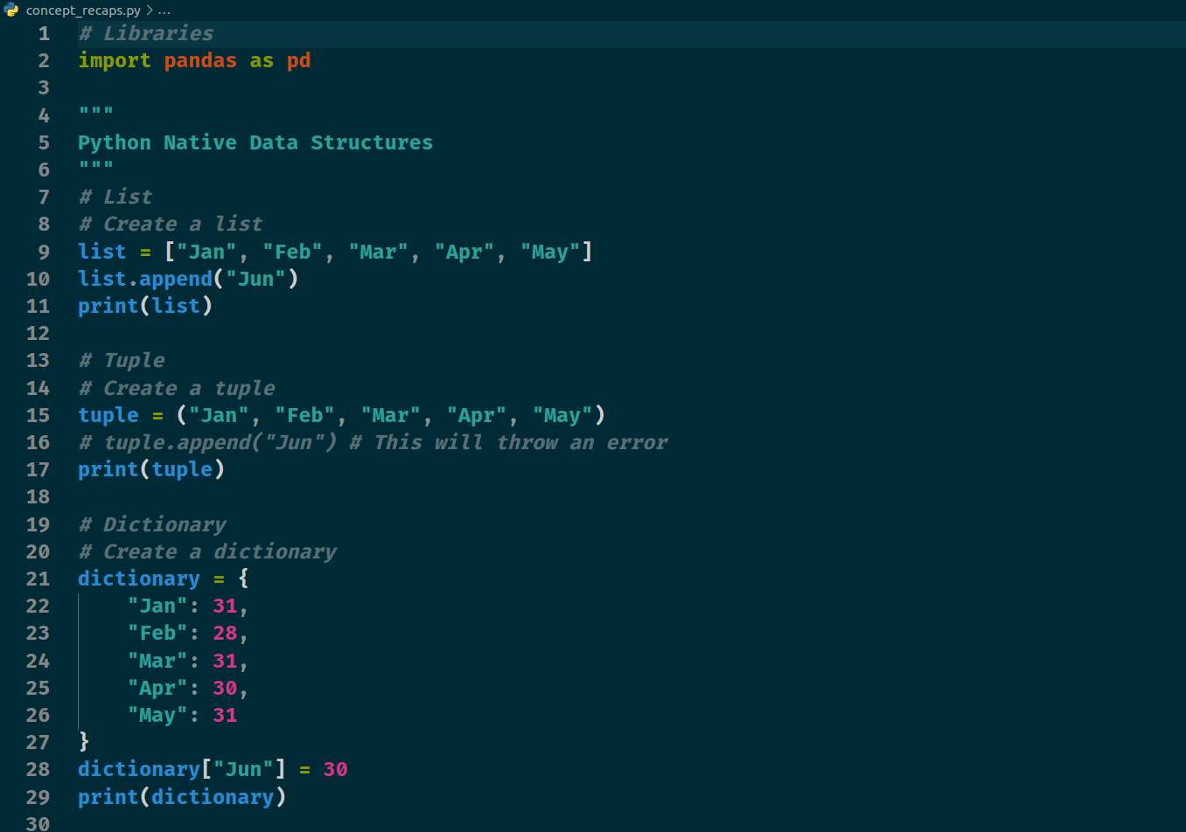
Developed by Guido van Rossum in 1991
Naming was inspired by Monty Python
Successor to the ABC language
Maintained by the Python Software Foundation
Easy for beginners + Smooth learning curve
Rich and powerful visualization libraries
Support matrix / vectorized operations via external libs
Notes:
http://manuals.bioinformatics.ucr.edu/home/programming-in-r

Slide 6
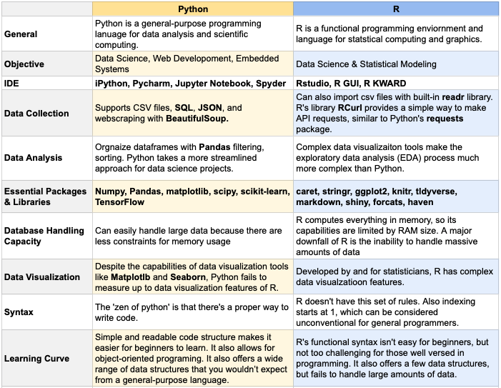
R vs. Python
Notes:
https://towardsdatascience.com/python-vs-r-the-basics-d754c45c1596

Slide 7
2
AI/ML/NLP Explained

Slide 8
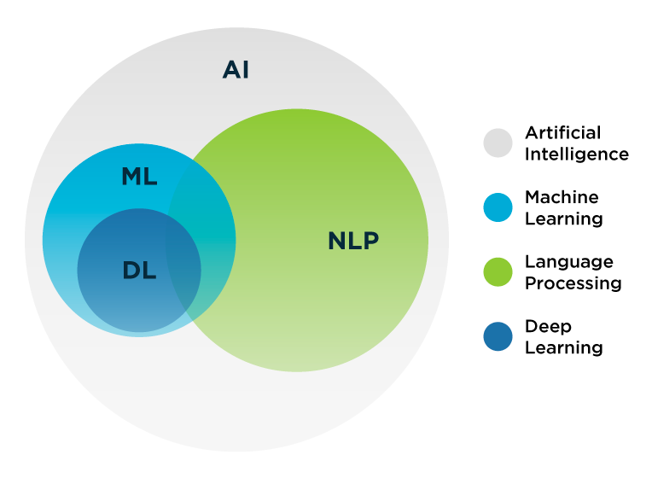
AI Domains
Notes:
https://datacenterfrontier.com/natural-language-processing-how-this-technique-can-take-your-business-to-the-next-level/

Slide 9
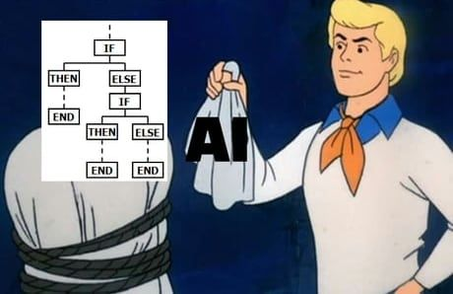

Artificial Intelligence
JOKE
Not Entirely True
Notes:
https://datacenterfrontier.com/natural-language-processing-how-this-technique-can-take-your-business-to-the-next-level/

Slide 10
AI Domains
Notes:
https://datacenterfrontier.com/natural-language-processing-how-this-technique-can-take-your-business-to-the-next-level/

Slide 11
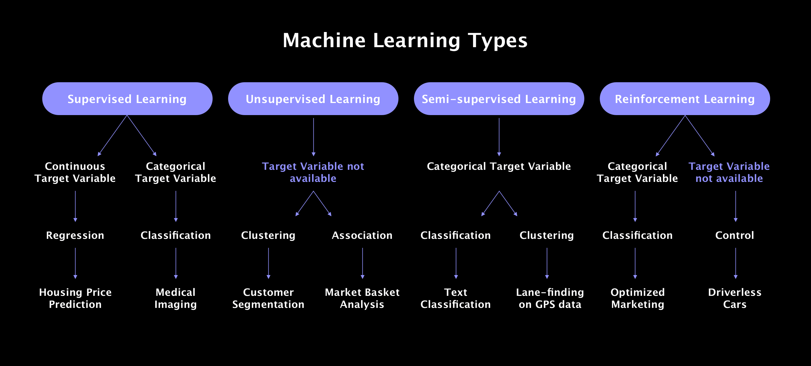
Machine Learning Family Tree
Notes:
https://litslink.com/blog/an-introduction-to-machine-learning-algorithms.

Slide 12
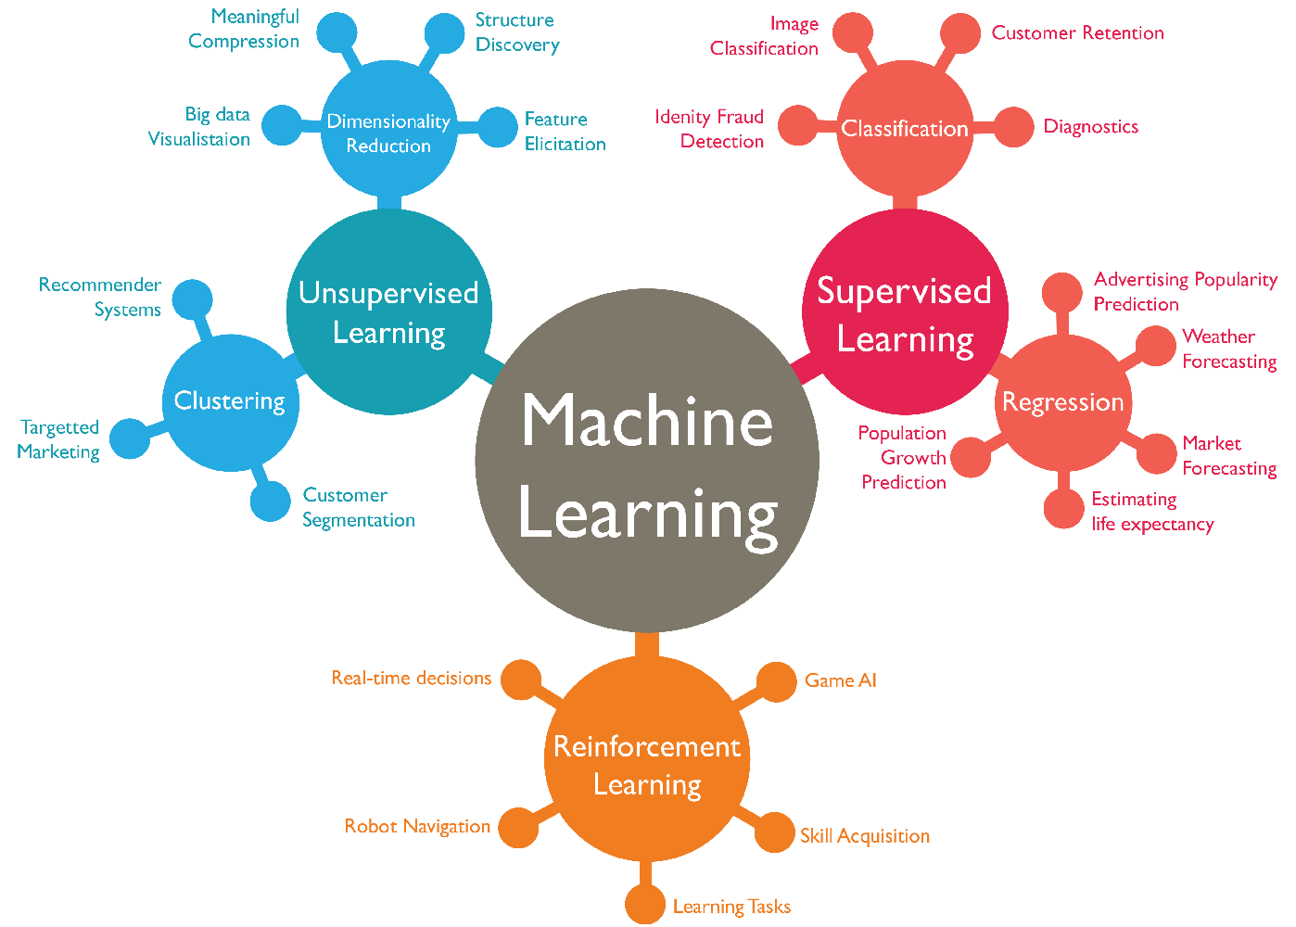
Machine Learning Family Tree
Notes:
https://www.isaziconsulting.co.za/machinelearning.html

Slide 13
AI Domains
Notes:
https://datacenterfrontier.com/natural-language-processing-how-this-technique-can-take-your-business-to-the-next-level/

Slide 14
Deep Learning: Fundamental Architecture
Feature / Architecture | ANN/MLP | RNN | CNN
What is it? | Basic neural network | Neural network with “memory” | Neural network for grid-like data
Advantages | Typically easier to train | Captures sequential information and preserves dependency | Captures spatial features and relationships
Challenges | Overfit easily even in simple networks | “Error” amplification (gradual or exponential) | Requires large amount of data
Typical Use | Classification Non-linear regressions | Time series Texts and audios | Image Recognition Video Processing
Notes:
https://www.isaziconsulting.co.za/machinelearning.html

Slide 15
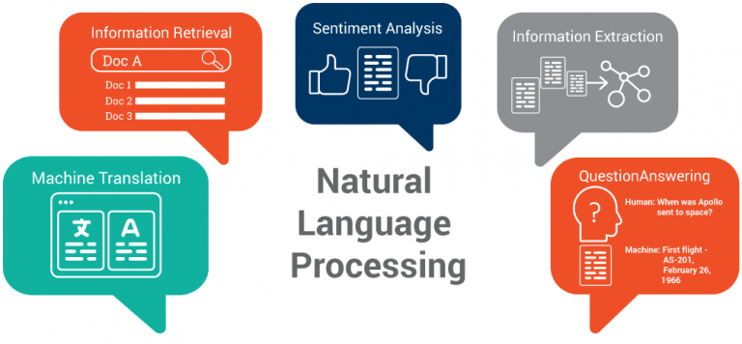
Types of NLP
Notes:
https://www.kdnuggets.com/2018/10/main-approaches-natural-language-processing-tasks.html
Information extraction
Sentiment analysis

Slide 16
Recent Example: ChatGPT
Version | Parameters Count | Dataset
GPT-1 | 0.12 Billion | BookCorpus
GPT-2 | 1.5 Billion | WebText
GPT-3 | 175 Billion | CommonCrawl, WebText, English Wikipedia, Books 1 and Books 2 Corpora
GPT-4 | 1.76 Trillion | All of the above + YouTube + Twitter + Textbooks (fine tuned by Scale AI)
Notes:
https://www.kdnuggets.com/2018/10/main-approaches-natural-language-processing-tasks.html
Information extraction
Sentiment analysis

Slide 17

Tech Steamroller
Notes:
https://www.kdnuggets.com/2018/10/main-approaches-natural-language-processing-tasks.html
Information extraction
Sentiment analysis

Slide 18
3
Text Analysis
Notes:
https://www.cxtoday.com/analytics/text-analytics-vs-text-mining/
https://www.excelr.com/text-mining-vs-text-analytics

Slide 19
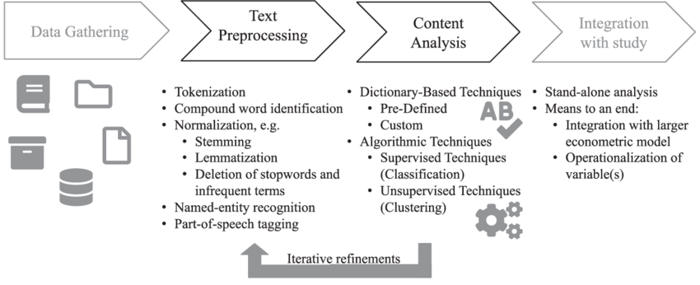
Process & Techniques
Notes:
https://www.researchgate.net/figure/Text-mining-process-and-techniques_fig1_340830772
Apply for spelling-based languages

Slide 20
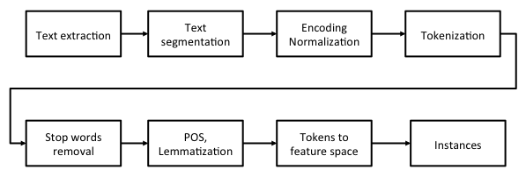
Process & Techniques
Notes:
https://subscription.packtpub.com/book/big-data-and-business-intelligence/9781788474399/10/ch10lvl1sec60/topic-modeling-for-bbc-news
https://atutor.ca/text-features/

Slide 21
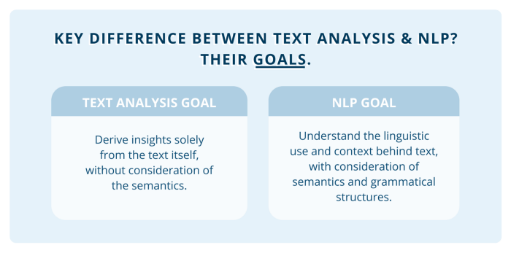
Goals
Notes:
https://towardsdatascience.com/a-guide-text-analysis-text-analytics-text-mining-f62df7b78747

Slide 22
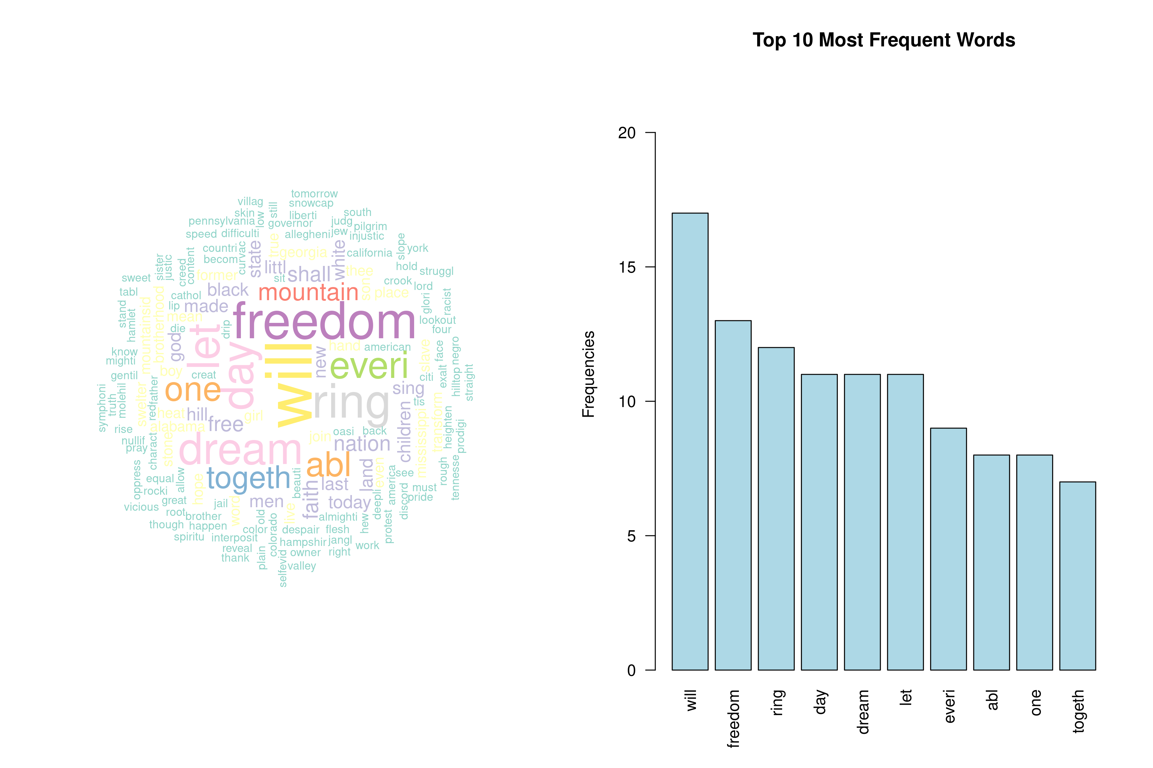
Example: Word Cloud & Word Frequency

Slide 23
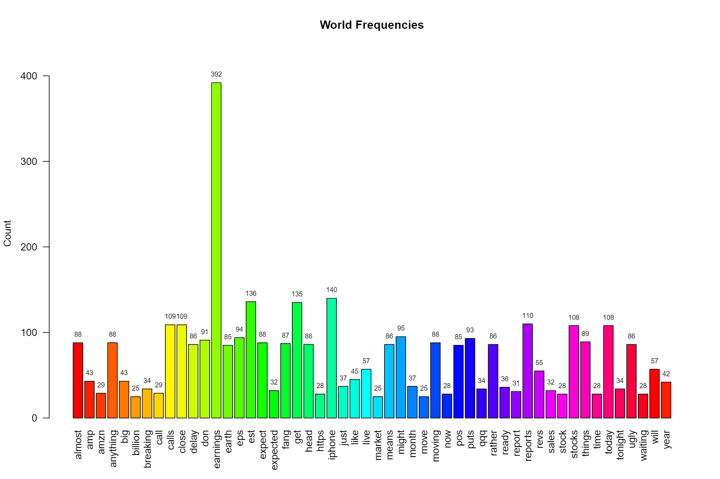
Example: Word Frequency

Slide 24
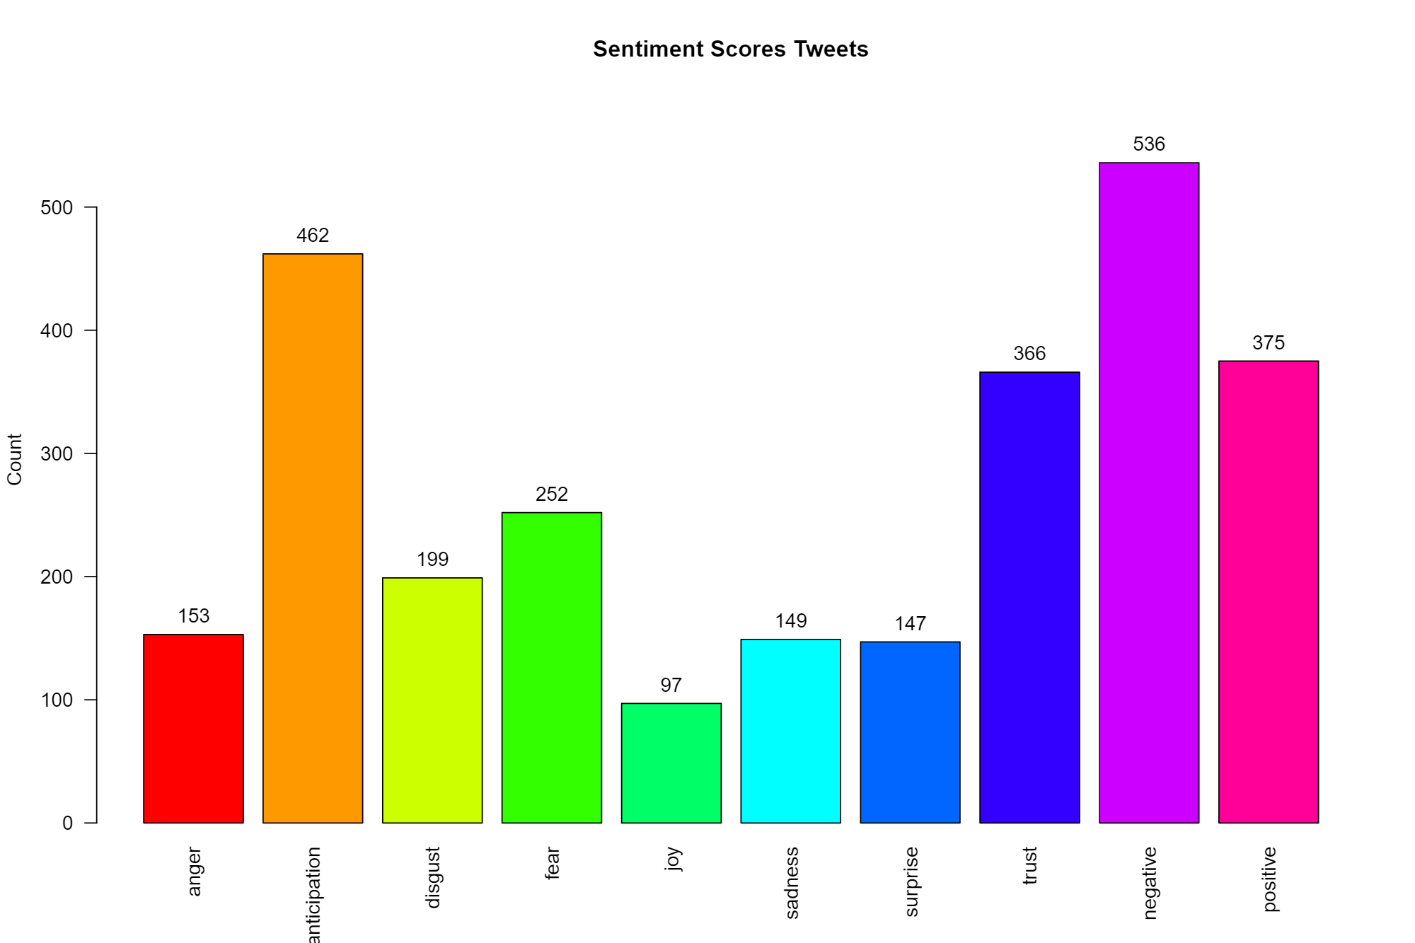
Example: Tweet Sentiment

Slide 25
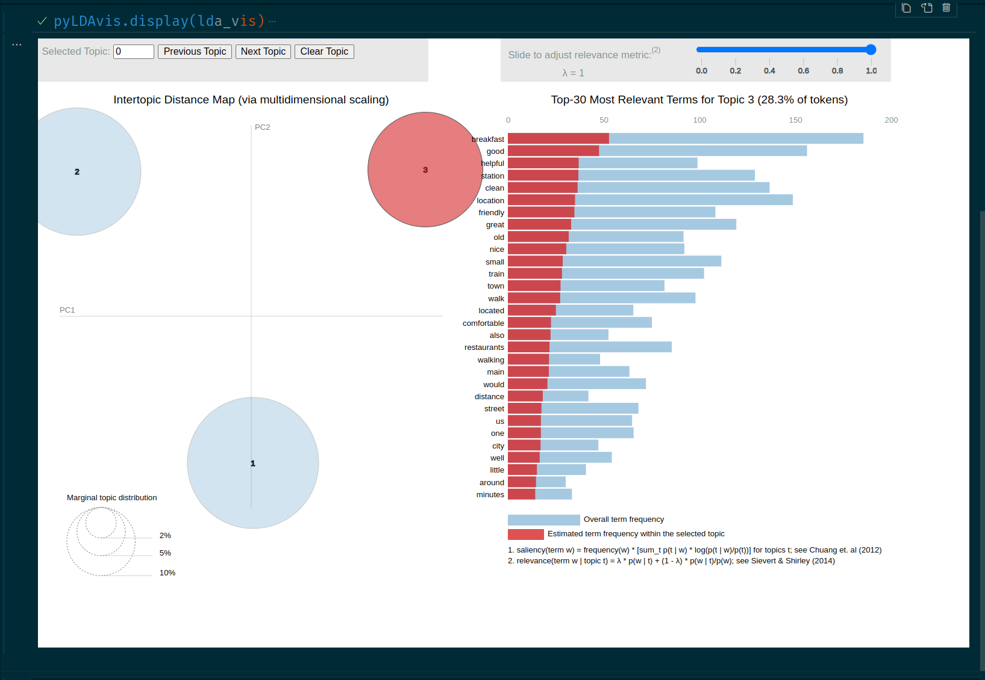
Example: Topic Modeling

Slide 26
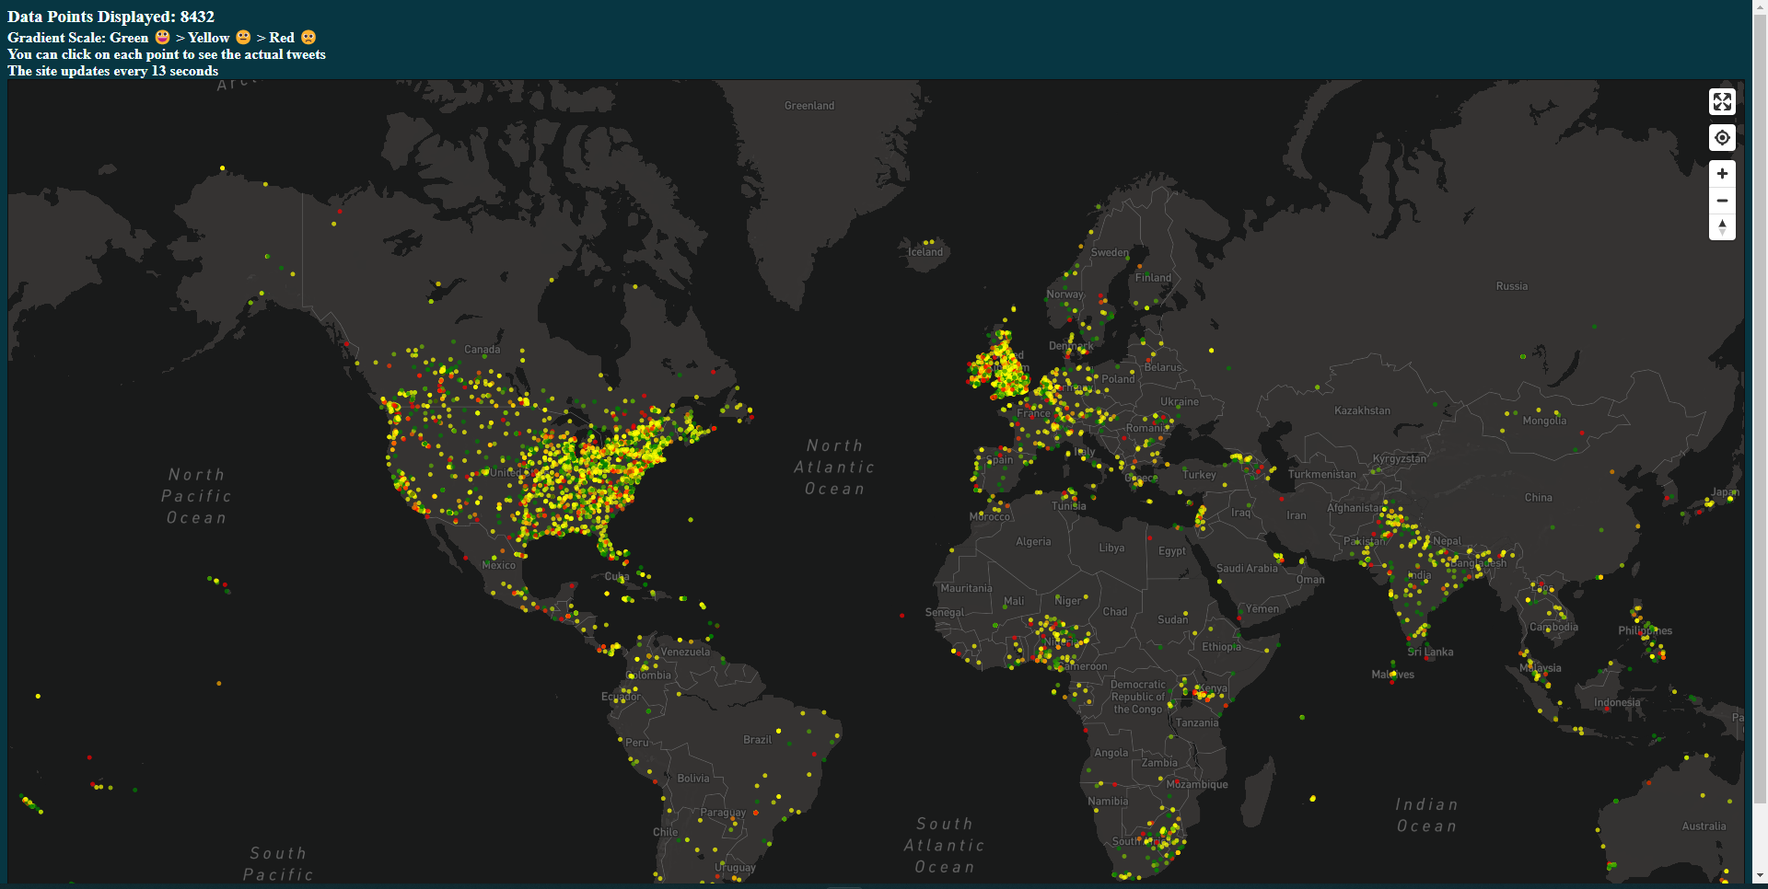
Examples: Covid Sentiment Map
Notes:
https://moodli.org/

Slide 27
4
Let’s Code

Slide 28
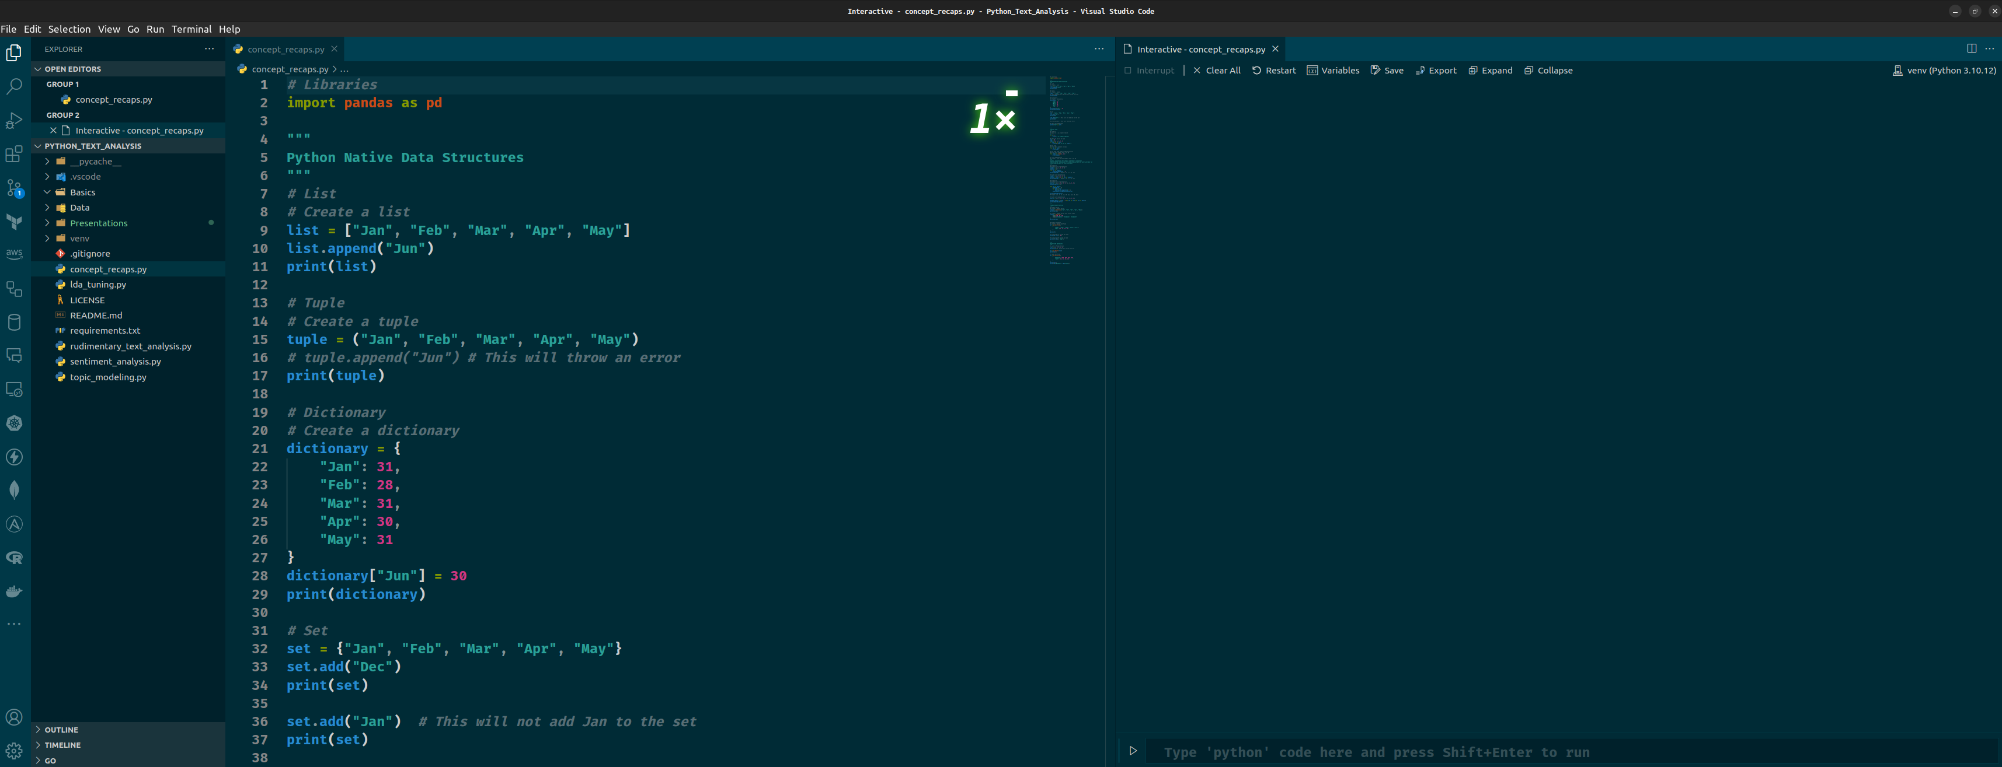
Visual Studio Code
Notes:
https://itueconomics.github.io/bil113e/r-week1.html

Slide 29
Thank You

